Slide 1

GCSE Construction and the Built Environment

Slide 2
Why Choose Construction?
Provides students with a broad background to, and core knowledge and understanding of the construction industry.
Encourages students to develop craft, CAD and technical skills
Helps students to make informed choices about their careers and how they will progress.
Encourages students to develop and practice the key transferable skills and have a positive attitude towards sustainable construction techniques.
100% A* - C since the specification began 12 years ago
50% coursework 50% exam improves grade performance

Slide 3

Benefit to learners
We have designed this specification to help learners develop:
A core knowledge of the construction industry
An ability to apply their knowledge in relevant, enjoyable and work related contexts for craft operations and CAD projects.
Key transferable skills that are important in working life
The ability to research the materials used in the construction of domestic and commercial buildings

Slide 4

Course Summary
Unit 1:Introduction to the built environment– one externally set worth 20% - this unit covers occupations within the construction industry, candidates must also research the different types of buildings and construction methods used in Northern Ireland. This paper is 1 hour and is externally assessed at the end of year 1
Unit 2: Sustainable Construction – external written examination based on pre-release material 1 hour 30 minutes worth 30%, assessed at the end of year 2
Unit 3: Construction Craft Project – controlled assessment, internally assessed and externally moderated 25% weighting.
Unit 4: Computer Aided Design in Construction – controlled assessment, internally assessed and externally moderated, 25% weighting.

Slide 5

What can I use Construction for?
Entry into AS Construction St. Louis and SRC - BTEC
University courses such as:
Property and construction
Construction management
Building, engineering and materials
Construction business and management
Engineering
Quantity surveying and commercial development
Construction Business and Project management – UUJ
Construction Engineering and management – UUJ
Energy and Building Services Engineering – UUJ
Product and Furniture Design – Belfast
Quantity Surveying and Commercial Management – UUJ
Environmental Planning – Queens
Land Use and Environmental Management – Queens

Slide 6
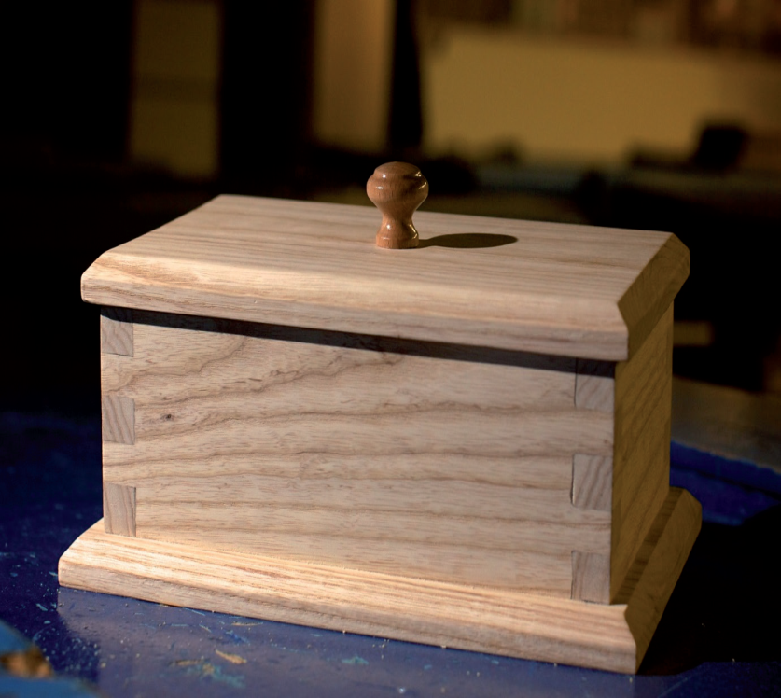
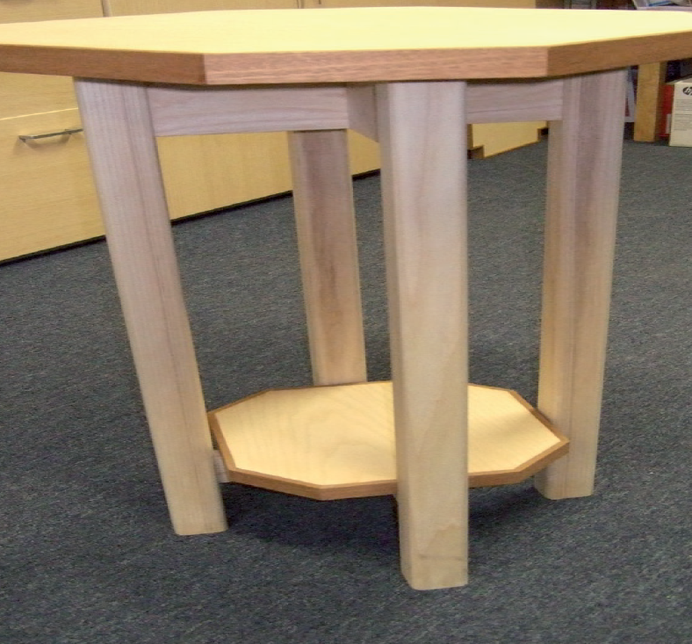
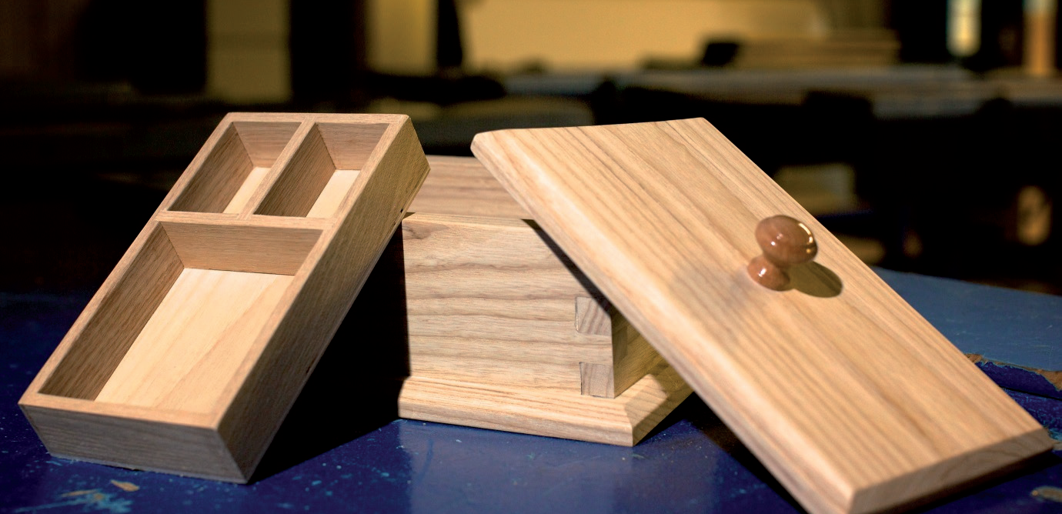
Sample Projects

